Slide 1



Architectures Explored
What’s inside blockchain, and how it fits in a systems architecture
Blockchain Explored Series
IBM Blockchain Platform Explored
Architectures Explored
Fabric Explored
Composer Explored
What’s New
V3.0, 26 September 2018
Notes:
This is a technical dive into blockchain architectures. Presentations in the “Explored” series are:
IBM Blockchain Platform Explored: How the IBM Blockchain Platform works.
Architectures Explored: Good blockchain architectures
Fabric Explored: Technical dive on Hyperledger Fabric
Composer Explored: Technical dive on Hyperledger Composer
What’s New: Recent developments in Fabric, Composer and IBP.

Slide 2
Blockchain Data Structures
Describing the blockchain using computer science principles
Operational Considerations
Consensus, integration, security, business and non-functional requirements
Notes:
This presentation is in three sections:
What is Blockchain: Covers the essentials of blockchain for business
Why is it relevant: Key use-cases
How can IBM help: IBM’s value proposition and the state of the technology

Slide 3
Note
Blockchain implementations vary
We’ll try and focus on what’s common and point out when implementations vary

Slide 4
The Linked List
Linear collection of data elements
Each element is linked to the next
Concept dates from 1955
abc
def
ghi
X
Notes:
Wikipedia: Linked lists were developed in 1955–1956 by Allen Newell, Cliff Shaw and Herbert A. Simon at RAND Corporation as the primary data structure for their Information Processing Language.

Slide 5
One-Way Hash Functions
Any function that can be applied to a set of data that is guaranteed to produce the same output for the same input
One-way means that you can’t derive the input from the output
Often, outputs are unlikely to repeat for different inputs
Forms the basis of much cryptography
h(abc) = 7859
h(def) = 8693
h’(7859) = ?
h(abc) = 7859

Slide 6
The Hash Chain
Hash chain: A successive application of a hash function
Can combine new data with each successive hash to produce a tamper resistant linked list
h(h(h(abc))) = 1859
h(ghi+h(def+h(abc))) = 5783

Slide 7
How is This Tamper Resistant?
def + 7859
ghi + 3785
abc
X
h(abc) = 7859
h(def + 7859) = 3785
h(ghi + 3785) = 5939
Any modification to a data element means that the hashes will not match up
You would need to recreate the downstream chain
XYZ + 7859
ghi + 3785
abc
X
h(abc) = 7859
h(XYZ + 7859) = 2957
Hash mismatch

Slide 8
Applied to Blockchain
A blockchain is a hash chain (with optimizations that we’ll cover shortly)
Each element (block) in the linked list is a set of zero or more transactions
Transactions are an implementation-dependent data object
First block known as a genesis block
May contain some identifying string or other configuration metadata
Genesis
tx1 +
tx2 + 6645
tx3 +
tx4 +
tx5 + 2311
X
h(Genesis) = 6645
h(tx1 + tx2 +
6645) = 2311
h(tx3 +
tx4 +
tx5 +
2311) = 0484

Slide 9
Some Problems with This Approach
In the event of tampering, it can be difficult to identify which transaction was modified (particularly when there are many transactions in a block)
It is not feasible to have one transaction per block
It requires all transaction data in order to retain integrity of chain
Searching transactions is linear (time consuming)

Slide 10
Merkle Tree
It is possible to optimise the chain data structure if we arrange it as a tree
Makes it easier to identify tampering without sacrificing stability
Makes it quicker to traverse
However, this makes it impossible to add new transactions without re-hashing root nodes
h( h(h(tx1)+h(tx2)) + h(h(tx3)+h(tx4)) )
h( h(tx1) + h(tx2) )
h( h(tx3) + h(tx4) )
h(tx1)
h(tx2)
h(tx3)
h(tx4)
tx1
tx2
tx3
tx4

Slide 11
Combining Tree and Chain
Each element in the chain contains:
A pointer (“Merkle root”) to the tree of transactions
Other metadata (e.g. timestamp)
A hash of the previous block’s data (i.e. Merkle root, metadata and hash)
h(meta1 +
1731 +
7693) = 3111
h(meta2 +
3111 +
3785) = 5939
h(Genesis) = 1731
Genesis
meta1 + 1731 + 7693
meta2 + 3111 + 3785
X
7693
3785
tx1
tx2
tx3
tx4
tx5
tx6
tx7

Slide 12
Benefits of This Approach
It allows tampered transactions to be identified easily
More efficient search within a block
O(log N) rather than O(N)
Allows transaction detail to be stubbed
Bitcoin has a Simplified Payment Verifier (SPV) concept: a type of user that doesn’t have the entire tree available, just the Merkel roots
Note it is also possible to checkpoint and archive old blocks, creating a new Genesis block mid-way through the chain

Slide 13
Common Transactions
What’s Dave’s balance?
Does Matt have funds to clear a £1000 transaction? (Assuming no overdraft)
# | Transaction | Initiator | Receiver | Amount
1 | Create a/c | Cash | Matt | £1000
2 | Create a/c | Cash | Dave | £2000
3 | Transfer | Matt | Dave | £100
4 | Create a/c | Cash | Ant | £500
5 | Transfer | Ant | Matt | £50
6 | Transfer | Ant | Dave | £200
7 | Transfer | Dave | Matt | £100
8 | Transfer | Dave | Ant | £50
9 | Transfer | Matt | Ant | £50

Slide 14
World State
It is clearly not feasible to reparse the entire transaction log to complete a new transaction
Blockchains often include an associated database (world state) – e.g. Hyperledger Fabric
Transactions become a set of creates, reads, updates and deletes of records in this data store
# | Transaction | Initiator | Receiver | Amount
1 | Create a/c | Cash | Matt | £1000
2 | Create a/c | Cash | Dave | £2000
3 | Transfer | Matt | Dave | £100
4 | Create a/c | Cash | Ant | £500
5 | Transfer | Ant | Matt | £50
6 | Transfer | Ant | Dave | £200
7 | Transfer | Dave | Matt | £100
8 | Transfer | Dave | Ant | £50
9 | Transfer | Matt | Ant | £50
Matt.balance = £1000
Dave.balance = £2150
Ant.balance = £350

Slide 15
Unspent Transaction Outputs
Some blockchains (e.g. Bitcoin) don’t maintain balances
Transactions are linked to earlier transactions using an ID (TXID)
Outputs always equal inputs
Unspent funds are marked as an “Unspent Transaction Output” (UTXO)
Only UTXOs can be used as inputs (to prevent double spending)
Your “balance” is the aggregation of all of your UTXOs
In Bitcoin, if your application doesn’t specify the UTXO output then the miner gets the excess!
Matt sends £40 to Dave
Matt sends £20 to Ant
Matt has £100
Input
Input
Out 1
Dave has £40
Out 1
Ant has £20
Out 2
Matt’s £60 UTXO
Out 2
Matt’s £40 UTXO

Slide 16

How Events are Used in Blockchain
In computing, an event is an occurrence that can trigger handlers
e.g. disk full, fail transfer completed, mouse clicked, message received, temperature too hot…
Events are important in asynchronous processing systems like blockchain
The blockchain can emit events that are useful to application programmers
e.g. Transaction has been validated or rejected, block has been added…
Events from external systems might also trigger blockchain activity
e.g. exchange rate has gone below a threshold, the temperature has gone up, a time period has elapsed…
txn
txn
txn
!
New txn
New txn handler
Transfer confirmed
Application
Notes:
Events are important in blockchains, because depending on the blockchain implementation it can take a long time to confirm transactions due to their distributed nature.
This slide describes the concepts of events in general, and contains how they might be used in blockchains.

Slide 17
Blockchain Data Structures
Describing the blockchain using computer science principles
Operational Considerations
Consensus, integration, security, business and non-functional requirements

Slide 18
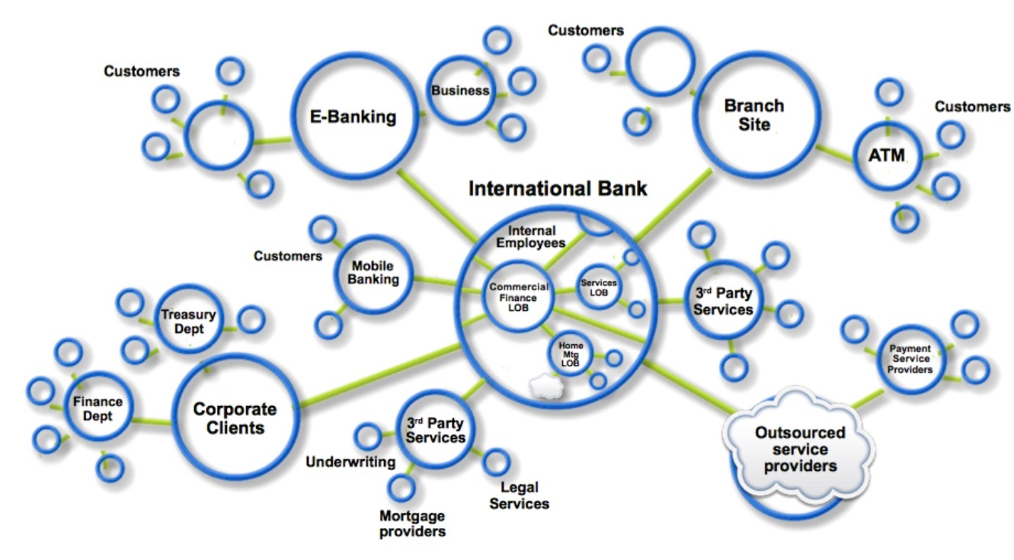
The Power of the Network
These data structures are just bytes on disk
Can still be manipulated or destroyed (e.g. by a DB admin)
Proof (and trust) in the blockchain comes from the power of the network…

Slide 19
Network Nodes
A blockchain network comprises a set of nodes that share information
Usually peer-to-peer
Some blockchains are worldwide, others are private to a business network
It might make sense to have one node per business network participant, but this is not necessarily so
Responsibilities include
Holding and maintaining the ledger
Receiving transactions from applications (and other nodes)
Validating transactions
Notifying applications about the outcome of submitted transactions
There is an assumption that some nodes might be malicious!
Different networks require different tolerances for malicious behaviour

Slide 20
The Art of Maintaining a Consistent Ledger
Keeping nodes up-to-date
Fixing any peers in error
Ignoring all malicious nodes
before
after
abc
def
abc
abc
CONSENSUS
abc
XYZ
abc
XYZ

Slide 21
Consensus Algorithms
There are lots of ways of achieving this
Proof of Work (e.g. Bitcoin, Ethereum)
Proof of Stake (e.g. NXT)
Proof of Elapsed Time (e.g. Sawtooth)
BFT-based (e.g. Iroha)
Apache Kafka/Zookeeper-based (e.g. Fabric)
Different algorithms have different qualities of service
Tolerances for malicious behavior
Compute requirements
Performance characteristics
Need for intrinsic incentives

Slide 22

One of Many Transaction Flow Implementations
1. The application submits a request to invoke a transaction
2. The transaction is shared around the network
3. A designated peer creates a block containing the transaction
△?
△?
△
△?
△?
△?
△?
△?
△?
4. The block’s transactions are executed and output stored in a delta
5. The network attempts to agree the correct result
6. If there is agreement, the correct output is applied to the world state

Slide 23
A Note on Cryptographic Mining
Cryptographic Mining is a by-product of Proof of Work (PoW)
It makes no sense with other consensus mechanisms
In PoW, nodes show they are legitimate by proving to other nodes that they have burned electricity
They do this by revealing the answer to difficult cryptographic puzzles
This causes other nodes to add the solver’s version of events (block) to their chain
The first solver (i.e. the producer of the block) gets rewarded
A bounty of 12.5 bitcoins (this halves every 210,000 blocks)
Any transaction fees present
The Bitcoin community refers to this “mining”, as running a node can occasionally result in Bitcoin rewards
Notes:
Currently this bounty is 12.5 bitcoins; this value will halve every 210,000 blocks.

Slide 24
Integrating with Existing Systems – Possibilities
2. Blockchain events
1. System events
!
!
Existing systems
Call into blockchain network from existing systems
Transform
Blockchain network
Call out to existing systems
Existing systems
Notes:
Events are crucial in integrating with existing systems as they allow you to trigger behaviour, either when something happens in the blockchain (e.g. update a UI when a transaction is confirmed), or when something happens in an external system (e.g. a system clock tells us ten minutes has passed).
Of course, instead of triggering this behaviour through events, you can also (3) instantiate blockchain transactions directly from existing systems, or (4) external actions directly from the blockchain.

Slide 25
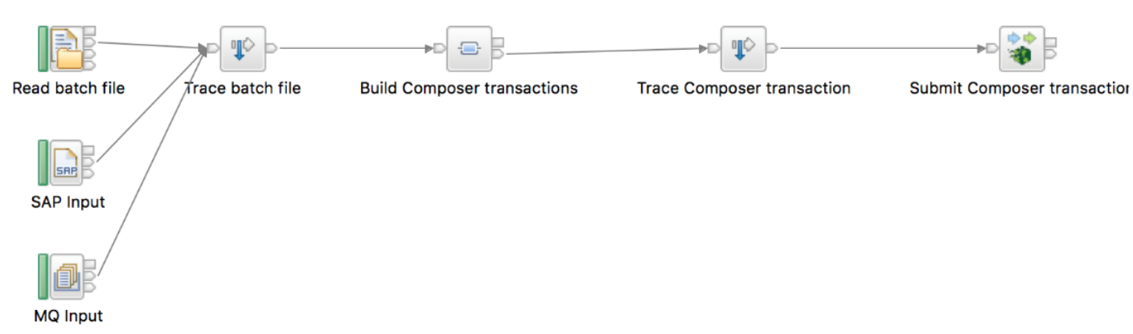
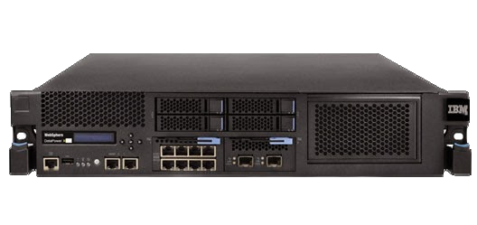
Integrating with Existing Systems – Using Middleware
Blockchain is a network system of record
Two-way exchange
Events from blockchain network create actions in existing systems
Cumulative actions in existing systems result in Blockchain interaction
Transformation between blockchain and existing systems’ formats
GBO, ASBO is most likely approach
Standard approach will be for gateway products to bridge these formats
Gateway connects to peer in blockchain network and existing systems
Smart contracts can call out to existing systems
Query is most likely interaction for smart decisions
e.g. all payments made before asset transfer?
Warning: Take care over predictability: transaction must provide same outputs each time it executes…
Notes:
It’s logical to use middleware as a means of transferring data between blockchains and external systems. The top screenshot shows an integration flow in IBM Integration Bus, showing how data originating in a file, SAP or MQ can be used to issue a transaction running on Hyperledger Composer. The picture at the bottom is of an IBM DataPower appliance which can also be used to integrate with blockchains.
There is a need to decide on the data formats to use inside the blockchain, and the interchange formats with existing systems. GBO stands for Generic Business Object, and ASBO stands for Application-Specific Business Object.

Slide 26
Non-determinism in blockchain
Blockchain is a distributed processing system
Smart contracts are run multiple times and in multiple places
As we will see, smart contracts need to run deterministically in order for consensus to work
Particularly when updating the world state
It’s particularly difficult to achieve determinism with off-chain processing
Implement oracle services that are guaranteed to be consistent for a given transaction, or
Detect duplicates for a transaction in the blockchain, middleware or external system
random()
getExchangeRate()
getDateTime()
getTemperature()
incrementValue
inExternalSystem(…)
Notes:
Be aware that systems integration in blockchain is DIFFICULT to get right because of its distributed nature. Individual transactions are run multiple on multiple nodes and as we’ll see in the next section, the network needs to agree on the result in order for consensus to be achieved.
Therefore, you can’t do things like random numbers as each invocation will probably return a different result, and consensus will not be achieved. Even things like timestamps, exchange rates, temperature readings and mileage of a moving car will be susceptible to minor variances, so cannot be relied on.
The problem gets worse when calling out to external systems, because it is easy to get into a situation where the external system is called multiple times, with potentially different values. Think about a simple example of incrementing a value in an external system. The result will be dependent on how many nodes there are in the blockchain network, as each invocation of the smart contract will cause the value to be incremented.
To get round this problem, you need to detect duplicate invocations either in the blockchain, middleware or external system – or otherwise guarantee consistency for a given transaction
Read up on the concepts of ‘oracles’ or ’cryptlets’ for more details on these.

Slide 27


Security: Public vs. private blockchains
Public blockchains
Private blockchains
For example, Bitcoin
Transactions are viewable by anyone
Participant identity is more difficult to control
For example, Hyperledger Fabric
Network members are known but transactions are secret
Some use-cases require anonymity, others require privacy
Some may require a mixture of the two, depending on the characteristics of each participant
Most business use-cases require private, permissioned blockchains
Network members know who they’re dealing with (required for KYC, AML etc.)
Transactions are (usually) confidential between the participants concerned
Membership is controlled
Notes:
Moving onto the topic of security.
Making the assumption that public blockchains are anonymous (or at least pseudononymous). This may not always be the case but is a reasonable assumption for now.
Think of privacy as being the polar opposite of anonymity: Anonymity = you know something happened but not who did it; Privacy = you know who did something but not what they did.
Most businesses have KYC requirements, which necessitates privacy rather than anonymity.

Slide 28



Security: Real-world vs. digital identity
Consider real-world identity documents…
The issuers of the identity documents are trusted third parties (e.g. passport office)
There is usually a chain of trust (e.g. to get a bank card you need a drivers license or passport)
Identity documents are often stored in wallets
In the digital world, identities consist of public/private key pairs known as certificates
Identity documents are issued by trusted third parties known as Certificate Authorities (CAs)
Private blockchain networks also require CAs
So network members know who they’re dealing with
May sit with a regulatory body or a trusted subset of participants
R
CA
U
CA
U
Notes:
A recap of security in the digital world and how it relates to security in the real world.

Slide 29
Security: Encryption and Signing
Cryptography basics
Every member of the network has (at least) one public key and one private key
Assume that every member of the network knows all public keys and only their own private keys
Encryption is the process applying a transformation function to data such that it can only be decrypted by the other key in the public/private key pair
Users can sign data with a private key; others can verify that it was signed by that user
For example
Alice can sign a transaction with her private key such that anyone can verify it came from her
Anyone can encrypt a transaction with Bob’s public key; only Bob’s private key can decrypt it
In private, permissioned blockchains
Transactions and smart contracts can be signed to verify where they originated
Transactions and their payloads can be encrypted such that only authorized participants can decrypt
Notes:
A recap of public key infrastructure (PKI) and how that can apply to blockchain.
A good opportunity to whiteboard the basics.

Slide 30
Certificate Authorities and Blockchain
Blockchain User A
Blockchain User B
Certificate Authority
requests certificates
Certs
U
U
issues certificates
uses
uses
signs / encrypts transactions
Client
Application
Client
Application
R
SDK
verifies/decrypts transactions
SDK
Blockchain
Notes:
A diagram that shows how encryption and signing can be used in a blockchain.

Slide 31
Business Considerations
As a B2B system, blockchain adds a number of aspects that are not typical in other projects:
Who pays for the development and operation of the network?
Where are the blockchain peers hosted?
When and how do new participants join the network?
What are the rules of confidentiality in the network?
Who is liable for bugs in (for example) shared smart contracts?
For private networks, what are the trusted forms of identity?
Remember that each business network participant may have different requirements (e.g. trust)
Evaluate the incentives of potential participants to work out a viable business model
Mutual benefit → shared cost (e.g. sharing reference information)
Asymmetric benefit → money as leveler (e.g. pay for access to KYC)
Notes:
Before any blockchain solution can be built, there are fundamental questions to ask related to how it gets paid for. These are particularly important given the nature of business networks and the importance they give to blockchain.

Slide 32
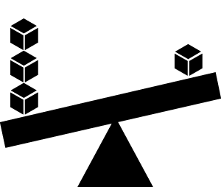
Trade-offs Between Non-Functional Requirements
Performance
The amount of data being shared
Number and location of peers
Latency and throughput
Batching characteristics
Security
Type of data being shared, and with whom
How is identity achieved
Confidentiality of transaction queries
Who verifies (endorses) transactions
Resiliency
Resource failure
Malicious activity
Non-determinism
Consider the trade-offs between performance, security and resiliency!
Notes:
Typically, if you want a blockchain solution to perform fast, you’ll need to trade-off against malicious behaviour. For example, proof of work is very slow but guards against many forms of malicious activity.

Slide 33


Non-Functional Requirements
Multi-tenant Cloud
Dedicated
Isolation
Low Controls
High Controls
Security
Single Site Development
High Availability & DR
Adjust the sliders with the client early in the project so all parties are aligned on the expectations of robustness, isolation, security controls etc. as all these factors have material impact on the cost and complexity of the solution.
Resilient Design
SaaS
On-Premise
Dev Options
Constrained
Ready For Growth
Sized For Growth
Monolithic
Highly Modular
Componentisation
Higher re-use
Custom Build
Re-Use
Proven
Leading Edge
Production Readiness
Low
High
Blockchain Network Complexity
Blockchain Network Security/Privacy Complexity
Low
High
Low
High
Blockchain SC Complexity
$
$$$
Notes:
Left is simpler/faster, Right is longer/Costly. Top sliders affect the complexity and price the most.

Slide 34
Summary
Blockchain builds on basic computer science concepts:
Linked Lists
Hash Functions
Peer-to-peer networks
Identify key operational considerations
Consensus is the art of maintaining a consistent ledger
It is possible to integrate with existing systems, but take care over determinism
Security requirements solved through techniques such as encryption and signing
Also consider business and non-functional requirements

Slide 35
Thank you
www.ibm.com/blockchain
developer.ibm.com/blockchain
www.hyperledger.org
© Copyright IBM Corporation 2017. All rights reserved. The information contained in these materials is provided for informational purposes only, and is provided AS IS without warranty of any kind, express or implied. Any statement of direction represents IBM's current intent, is subject to change or withdrawal, and represents only goals and objectives. IBM, the IBM logo, and other IBM products and services are trademarks of the International Business Machines Corporation, in the United States, other countries or both. Other company, product, or service names may be trademarks or service marks of others.

